Slide 1
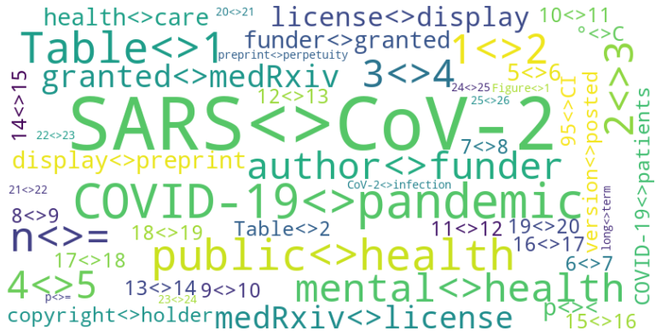
NLP ASSIGNMENT ONE
Edward Boguslavsky & Humza Fazal

Slide 2
OUR APPROACH
LANGUAGE
We used Python for it’s ease of use and it’s popularity in the NLP field
LIBRARIES
We used spaCy, matplotlib, and WordCloud for their NLP functionality and graphing capabilities
SOFTWARE
We used Spyder IDE for its popularity in ML and data visualization

Slide 3
OUR DATA SETS
VOCABULARY
A list of unique words in the text corpus
vocabulary('edward loves food', 'edward loves sleep', 'humza loves food')
>>> ['edward', 'loves', 'food', 'sleep', 'humza']

Slide 4
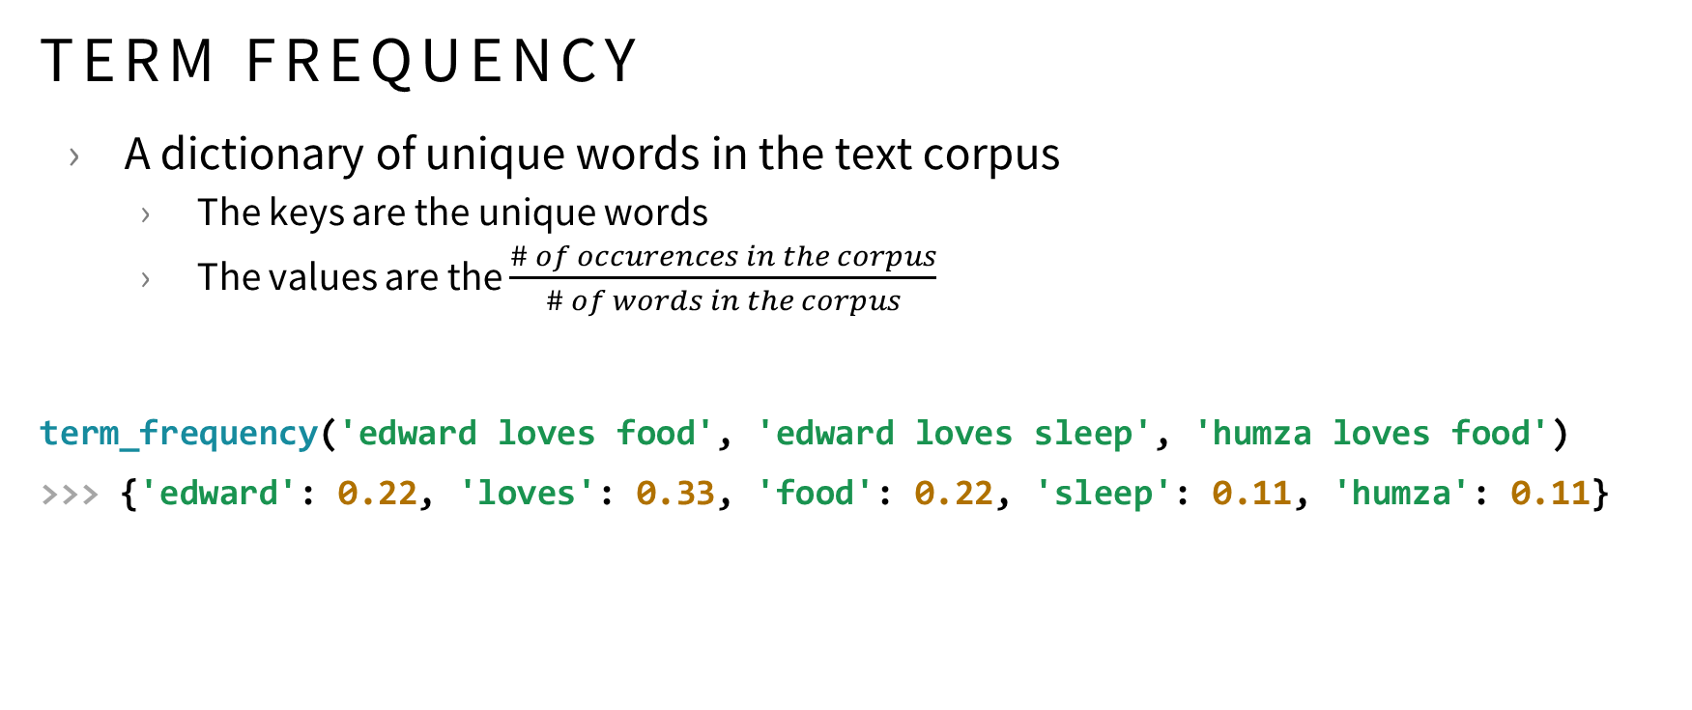
OUR DATA SETS
TERM FREQUENCY
A dictionary of unique words in the text corpus
The keys are the unique words
The values are the $\frac{\# of occurences in the corpus}{\# of words in the corpus}$
term_frequency('edward loves food', 'edward loves sleep', 'humza loves food')
>>> {'edward': 0.22, 'loves': 0.33, 'food': 0.22, 'sleep': 0.11, 'humza': 0.11}

Slide 5
OUR DATA SETS
ENTITIES
A dictionary of unique key words in the text corpus
The keys are the entities
The values are the number of occurrences in the corpus
spaCy provides an NER algorithm to automatically detect entities in text
Common entities include names, locations, businesses, phone numbers, etc.
entities('edward ate lunch at the campus', 'humza met edward on campus')
>>> {'edward': 2, 'campus': 2, 'humza': 1}

Slide 6
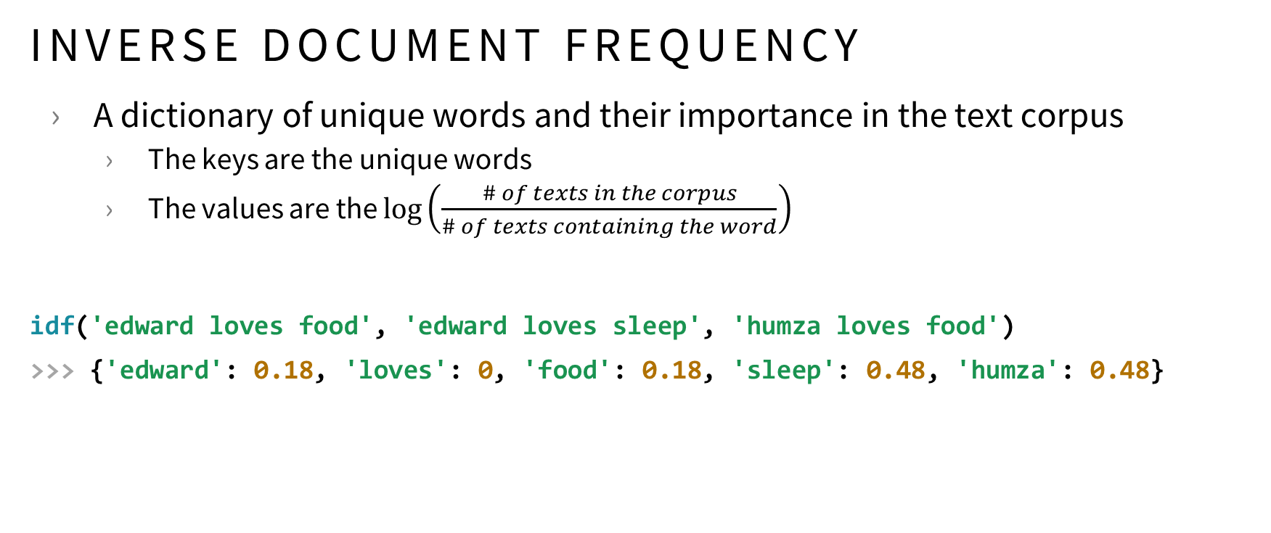
OUR DATA SETS
INVERSE DOCUMENT FREQUENCY
A dictionary of unique words and their importance in the text corpus
The keys are the unique words
The values are the $\log\left(\frac{\# of texts in the corpus}{\# of texts containing the word}\right)$
idf('edward loves food', 'edward loves sleep', 'humza loves food')
>>> {'edward': 0.18, 'loves': 0, 'food': 0.18, 'sleep': 0.48, 'humza': 0.48}

Slide 7
OUR DATA SETS
N-GRAM
A dictionary of commonly paired words and frequency in the text corpus
The keys are the n-grams
The values are the number of occurrences in the corpus
idf('edward loves food', 'humza loves food')
>>> [(('edward', 'loves'), 1), (('loves', 'food’), 2), (('humza', 'loves'), 1)]

Slide 8
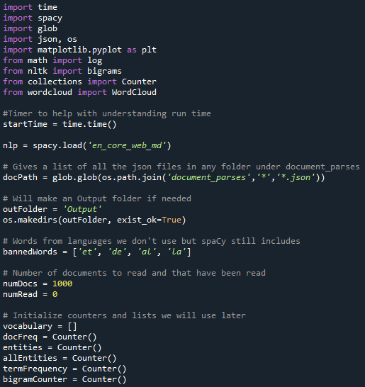
OUR CODE
IMPORTS AND VARIABLES
At

Slide 9
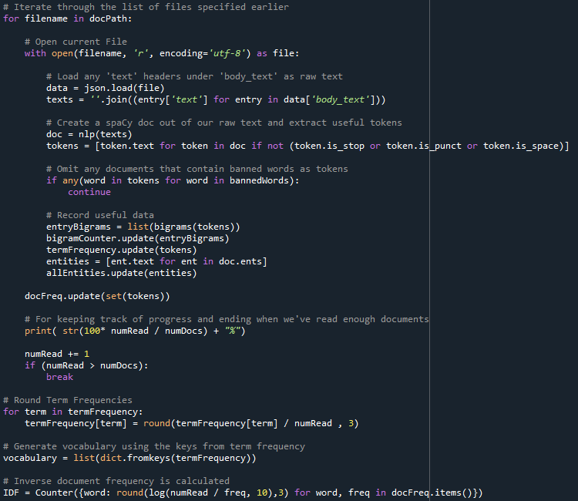
OUR CODE
ANALYSIS
A

Slide 10
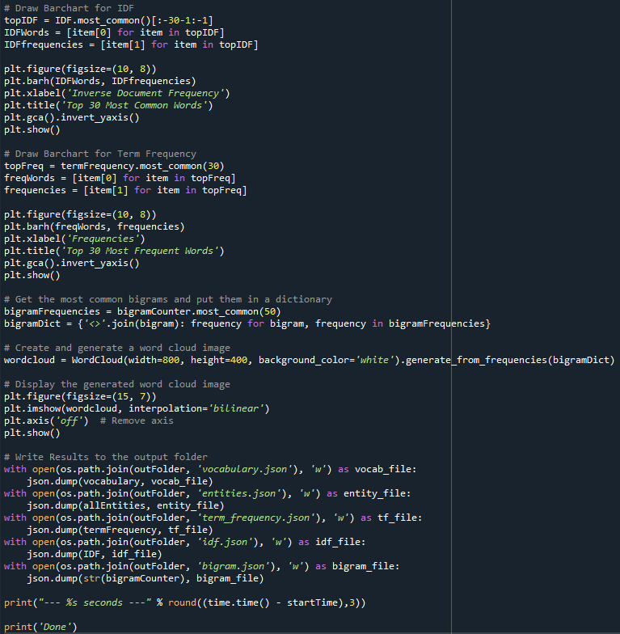
OUR CODE
EXPORTING DATA SETS
A

Slide 11
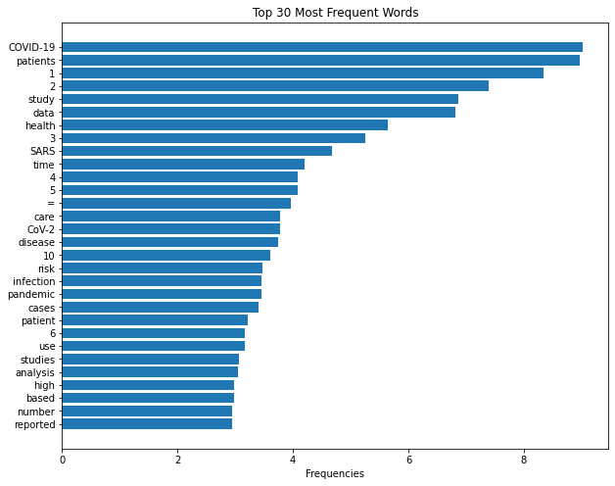
OUR FINDINGS
MOST FREQUENT WORDS
Using pyplot and our term frequency dataset we generated a bar graph of the “Top 30 Most Frequent Words”
This graph visualizes the average number of occurrences of each word in a scientific article from the CORD-19 dataset

Slide 12
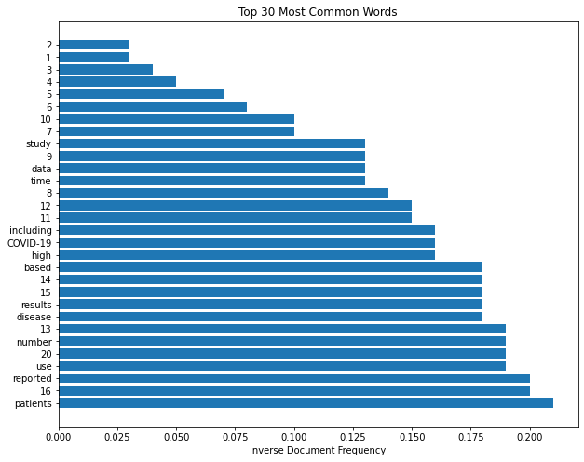
OUR FINDINGS
MOST COMMON WORDS
Using pyplot and our inverse document frequency dataset we generated a bar graph of the “Top 30 Most Common Words”
This graph visualizes the words that occur the most consistently across all the scientific articles from the CORD-19 dataset (lower IDF = more common)

Slide 13
OUR FINDINGS
MOST COMMON WORDS
Using WordCloud and our n-gram dataset we generated a word cloud of the top 50 most common bigrams
This graph visualizes the most frequently occurring bigrams across the scientific articles from the CORD-19 dataset (larger font = more frequent)

Slide 14
Vote For US GROUP 2

